Slide 1
The Value Contribution of Commodity Trading to the Swiss Economy
Bovet Olivier (SECO), Beaud Romain (OFS)
Zug
21.05.2025

Slide 2
Roadmap
History
The goal
The approach
The timeline

Slide 3
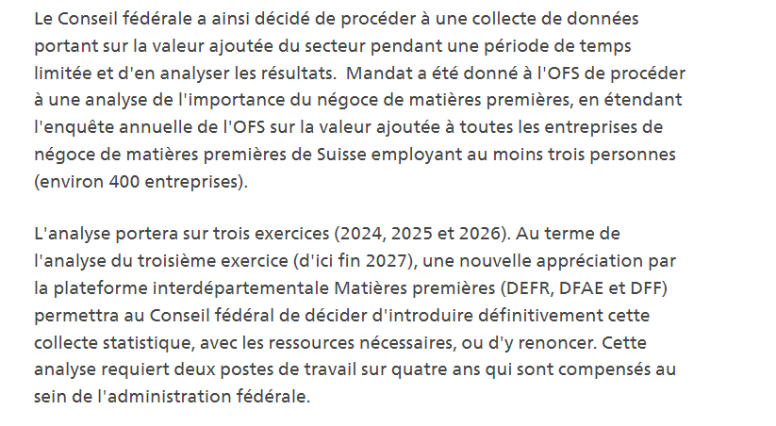
1. History
“Launch of data collection on the contribution of commodity trading to value added.”
22.11.2023
Value added
3 years (2024 to 2026)
Federal Council mandate
Expansion of the FSO's annual added value survey to all commodity trading companies.

Slide 4
2. The goal
Assess and understand the role of the
commodity sector in Switzerland.
Gross Domestic Product (GDP) Measure of economic growth
Value Added (VA) Measurement tool
Companies Actors holding the information

Slide 5
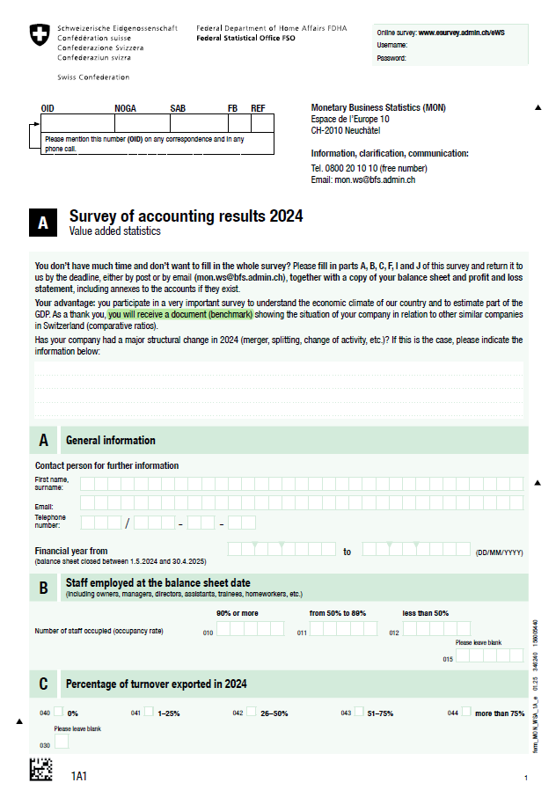
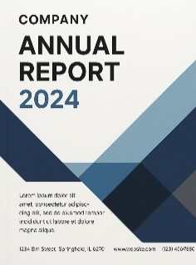
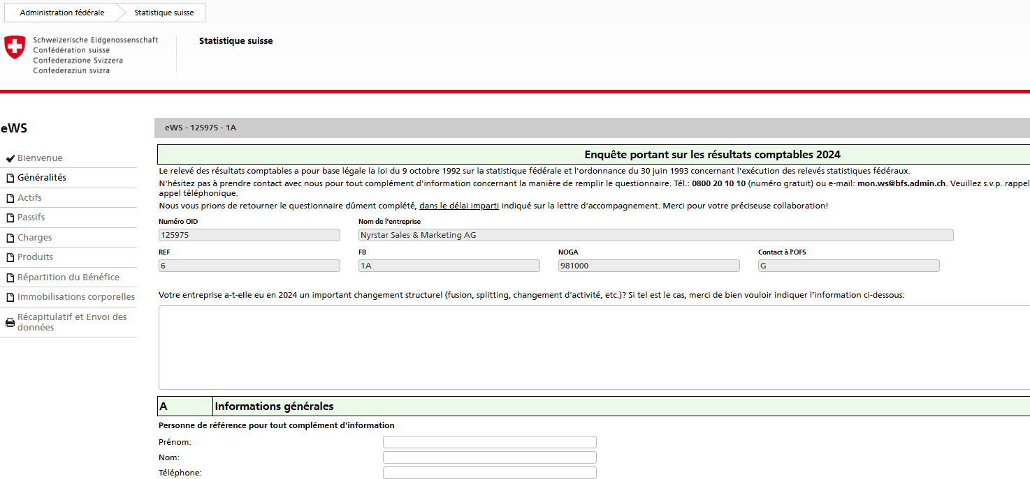
3. The approach
Selection of the enterprises to be surveyed
Based on economic criteria (size, type of activity, …)
Aligned with the Federal Council’s mandate (statistical restriction)
Definition of the data collection process
Paper form
Digital form
Submission of financial statements
https://www.esurvey.bfs.admin.ch/ews

Slide 6
4. The timeline
2025
2026
2027
2028
Early March
Forms submission
Forms submission
Forms submission
May 21st
Mid November
VA statistics release (2024)
Provisional results
VA statistics release (2025)
Provisional results
VA statistics release (2026)
Provisional results
-
VA statistics release (2025)
final results
VA statistics release (2026)
final results
-
VA statistics release (2024)
final results
Aggregated data : Value added of the Commodity sector. Possibly the GDP share of the Commodity sector.

Slide 7
Questions/remarks ?
Bovet Olivier (SECO), Beaud Romain (OFS)
Zug
21.05.2025

